Slide 1
Programming 4
03.1 Linked Lists
Semester 2, 2019

Slide 2
Data storage for games
How can we store all the data needed?
How can we represent objects in our game?

Slide 3
Static storage
Arrays
Advantages:
Easy to create and initialise
Easy to index into
Built into most development environments
Disadvantages:
Inflexible size
Awkward for deletion

Slide 4
Dynamic storage
Linked lists
Sequence of elements where each item
links to the next item
monster
monster
monster
monster

Slide 5
Dynamic storage
Linked lists
Sequence of elements where each item
links to the next item
head
tail
monster
monster
monster

Slide 6
Structure – Node object
Node
Node^ Next;

Slide 7
Structure – Linked list
Linked list
Node^ head;
Node^ tail;

Slide 8
Linked list operations
To create a linked list
Create a head node pointer
Create a tail node pointer
Set the both head and tail to null pointer

Slide 9
Linked list operations
To count the number of items in a linked list:
Start at the node pointed to by head
Node count equals zero
Loop through all nodes – head not equal to null pointer
Increment node count
Go to the next node in the linked list
Return the number of items

Slide 10
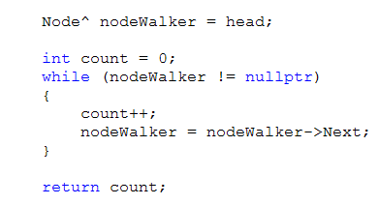
Linked list operations – code example

Slide 11
nodeWalker = nodeWalker->Next
nodeWalker is a Node pointer
It is not a Node
It has no Next property
So how can we talk about its Next?
When working with pointers, ptr->Next does not
mean “your Next property”
It means “the Next property of the object you are pointing at”

Slide 12
nodeWalker = nodeWalker->Next
So nodeWalker = nodeWalker->Next
Means:
Find the guy nodeWalker is pointing at
Take that’s guy’s Next value
Assign that value to nodeWalker

Slide 13
nodeWalker = nodeWalker->Next
nodeWalker
node1
node2

Slide 14
nodeWalker = nodeWalker->Next
nodeWalker
node1
node2

Slide 15

Linked list operations
To add a new node to an unordered linked list
Add it to the end
Process:
Set the Next pointer of the current last node to the new node
Set tail to the new node

Slide 16
Adding to a linked list
If the list isn’t empty (i.e. tail isn’t nullptr), add the new node to the end
If tail is nullptr?
Make both head and tail point to the new node

Slide 17
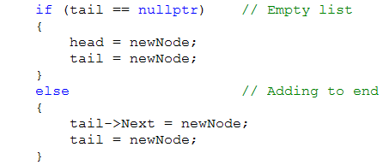
Adding to a linked list

Slide 18
Linked list operations
To delete a node
head
tail
monster1
monster2
monster3

Slide 19
Linked list operations
To delete a node
head
tail
monster1
monster2
monster3

Slide 20
Linked list operations
monster1->Next = monster2->Next
head
tail
monster1
monster2
monster3
Notes:
To delete monster2…simply set

Slide 21
Linked list operations
monster2’s memory will be garbage collected
head
tail
monster1
monster3
Notes:
We can delete it now if we want or we can just let it be garbage collected
The system will see that nobody points to it anymore, and will free it from the heap

Slide 22
Deleting
But how would we find monster1 (i.e. the node before the one we want to delete)?
Algorithm:
Start at the beginning
For each node ask “is the node after this one
(i.e. its Next) the one who is to be deleted?”
If so, it is the previous node
Set the Next of the previous node to the Next
of the node to be deleted

Slide 23
Deleting continued
Deleting monster3
head
tail
monster1
monster2
monster3
monster4
nodeToDelete
Notes:
The algorithm in action

Slide 24
Deleting continued
Deleting monster3
head
nodeWalker
tail
monster1
monster2
monster3
monster4
nodeToDelete
Notes:
Start at the beginning
NodeWalker = head

Slide 25
Deleting continued
nodeWalker = nodeWalker->Next
head
nodeWalker
tail
monster1
monster2
monster3
monster4
nodeToDelete
Notes:
Move along

Slide 26
Deleting continued
nodeWalker = nodeWalker->Next
head
nodeWalker
tail
monster1
monster2
monster3
monster4
nodeToDelete

Slide 27
Deleting continued
nodeWalker->Next now equals nodeToDelete
head
nodeWalker
tail
monster1
monster2
monster3
monster4
nodeToDelete

Slide 28
Deleting continued
nodeWalker->Next = nodeToDelete->Next
head
nodeWalker
tail
monster1
monster2
monster3
monster4

Slide 29
Deleting continued
monster3 will be garbage collected
head
nodeWalker
tail
monster1
monster2
monster4

Slide 30
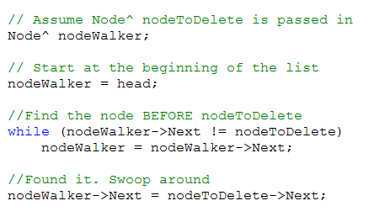
Deleting continued
Assume Node^ nodeToDelete is passed in
Start at the beginning of the list
Find the node before nodeToDelete
Found it. Swoop around
Notes:
Note that there’s actually more than we have here
We need to deal with the case where we are asked to delete a node that isn’t actually in the list, and there are boundary cases, for example, when you are deleting the first node, or deleting from a list that only has one node in it. Then there is no node before
When we build our own linked list, we will look at these, and there is a detailed handout to help you
For now, just make sure you understand the logic of this basic case of deleting a node from the middle of the list
Use a similar approach for adding a node to an ordered list

Slide 31
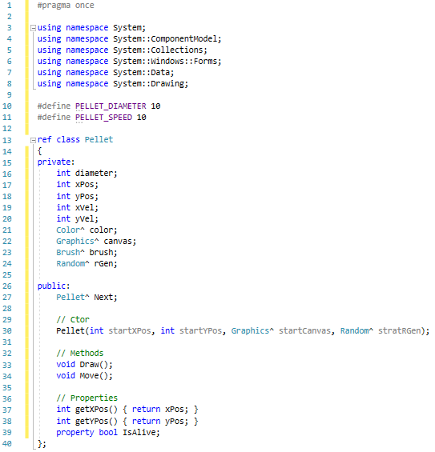
Pellet.h
Notes:
We are going to build a little pellet (coloured circle) class so we can start firing projectiles
We will need a Pellet class that can serve as a node – what will need??? Data fields and a Next pointer
We will need a linked list class for Pellets – we need a head and tail

Slide 32
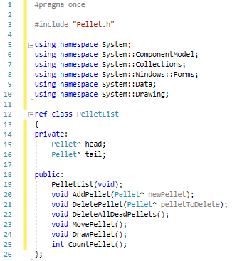
PelletList.h

Slide 33
KeyDown event handler
if (e->KeyData == Keys::Left)
Move chicken 10 pixels to the left
if (e->KeyData == Keys::Right)
Move chicken 10 pixels to the right
If (e->KeyData == Keys::Space)
Create new instance of Pellet
Add pellet to the linked list

Slide 34
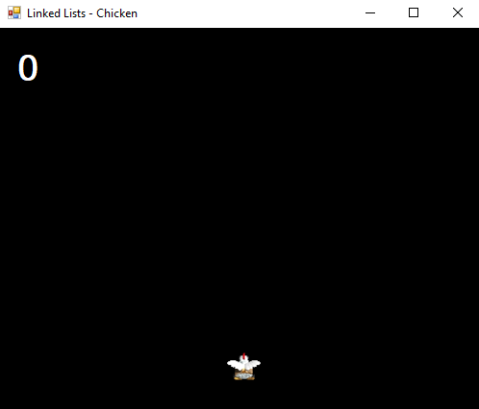
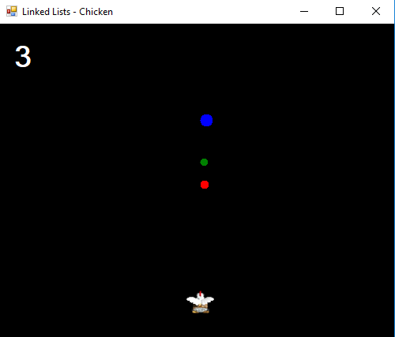
Practical – spitting chicken

